Slide 1
Data Analytics Lesson 18 – Spatial Analysis using R
Dr. Jeffrey Strickland

Slide 2
R Markdown
This is an R Markdown presentation. Markdown is a simple formatting syntax for authoring HTML, PDF, and MS Word documents. For more details on using R Markdown see http://rmarkdown.rstudio.com.

Slide 3
Key Libraies for Spatial Analysis
ggmap: extends the plotting package ggplot2 for maps
rgdal: R’s interface to the popular C/C++ spatial data processing library gdal
rgeos: R’s interface to the powerful vector processing library geos
maptools: provides various mapping functions
dplyr and tidyr: fast and concise data manipulation packages
tmap: a new packages for rapidly creating beautiful maps
install.packages(x)
install.packages(c(“rgdal”, “maptools”, “dplyr”, “tidyr”, “tmap”, “tmaptools”, “rgeos”))

Slide 4
Loading Libraries
library(maptools)
library(dplyr) library(tidyr) library(tmap) library(rgdal)
library(rgeos)
library(ggplot2) library(ggmap) library(raster)
library(DT)

Slide 5
Import India shape file (.SHP)
mydir<-"C:/Users/jeff/Documents/Crime Analysis/India_data" ind <- readOGR(dsn = mydir, layer = "INDIA")
## OGR data source with driver: ESRI Shapefile ## Source: "C:\Users\jeff\Documents\Crime Analysis\India_data", layer: "INDIA" ## with 35 features ## It has 1 fields

Slide 6
Import India Population Grid Files (.GRD)
The first file we are going to load into R Studio is the “INDIA” shapefile located in the “data” folder of the project.
It is worth looking at this input dataset in your file browser before opening it in R.
ind_pop<- raster("C:/Users/jeff/Documents/Crime Analysis/India_data/ind_pop.grd") ind_msk_pop<- raster("C:/Users/jeff/Documents/Crime Analysis/India_data/ind_msk_pop.grd")

Slide 7
Comments on Imported Data
In the second line of code above the readOGR function is used to load a shapefile and assign it to a new spatial object called “ind”; short for London.
readOGR is a function which accepts two arguments: dsn which stands for “data source name” and speci???es the directory in which the ???le is stored, and layer which speci???es the ???le name (note that there is no need to include the ???le extention .shp).
The file we assigned to the ind object contains the population of London Boroughs in 2001 and the percentage of the population participating in sporting activities.

Slide 8
Examining the Output
Take a look at the output created (note the table format of the data and the column names).
There are two important symbols at work in the above block of code: the @ symbol in the first line of code is used to refer to the data slot of the ind object.
The $ symbol refers to the Partic_Per column (a variable within the table) in the data slot, which was identi???ed from the result of running the first line of code.

Slide 9
SOme Comments about Spatial Objetcs
Spatial objects like the ind object are made up of a number of different slots, the key slots being @data (non geographic attribute data) and @polygons (or @lines for line data).
The data slot can be thought of as an attribute table and the geometry slot is the polygons that make up the physcial boundaries.
Specific slots are accessed using the @ symbol.
We analyse the INDIA object with some basic commands

Slide 10
Headers
The head function in the first line of the code above simply means “show the first few lines of data” (try entering head(ind@data), see ?head for more details).
head(ind@data, n = 2)
## ST_NAME ## 0 ANDAMAN AND NICOBAR ISLANDS ## 1 Andhra Pradesh

Slide 11
Classes
To check the classes of all the variables in a spatial dataset, you can use the following command:
sapply(ind@data, class)
## ST_NAME ## "factor"

Slide 12
Explore Spatial Structure
To explore ind object further, try typing
nrow(ind)
## [1] 35
ncol(ind)
## [1] 1
ind@proj4string
## CRS arguments: +proj=longlat +ellps=WGS84 +no_defs

Slide 13
Plotting Layers
Now we have seen something of the structure of spatial objects in R, let us look at plotting them.
Note, that plots use the geometry data, contained primarily in the @polygons slot.
plot(ind) # basic plot

Slide 14
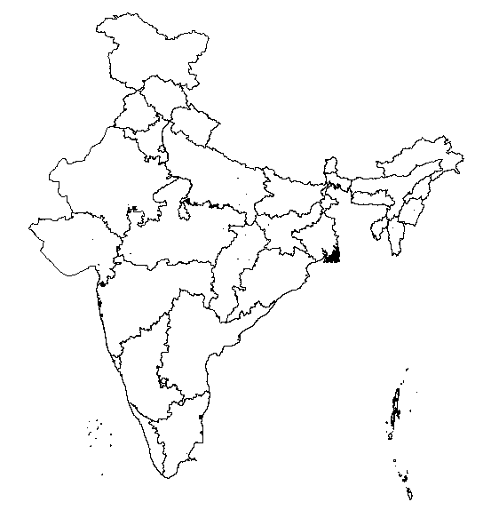
plot(ind_pop)

Slide 15
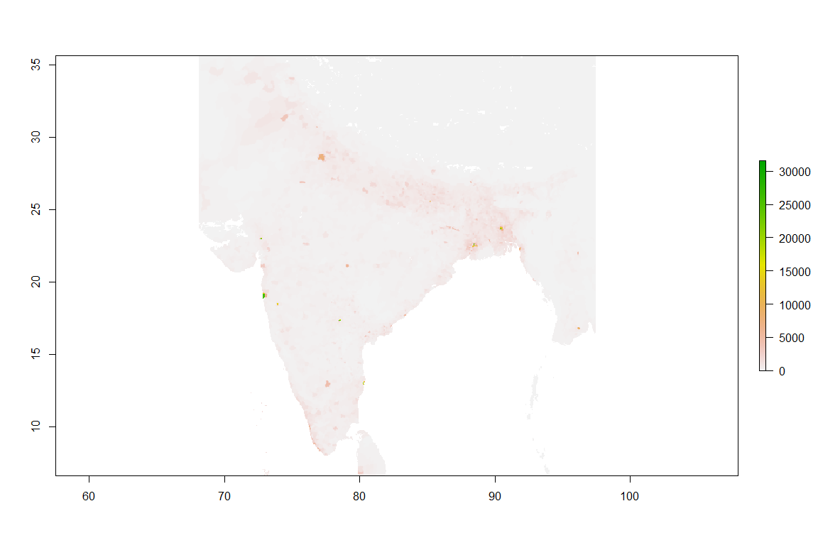
Population Grid Mask
raster::extent(ind)
## class : Extent ## xmin : 68.1202 ## xmax : 97.41516 ## ymin : 6.754256 ## ymax : 37.13564
plot(ind, xlim = c(68.1202, 97.41516), axes = TRUE)

Slide 16
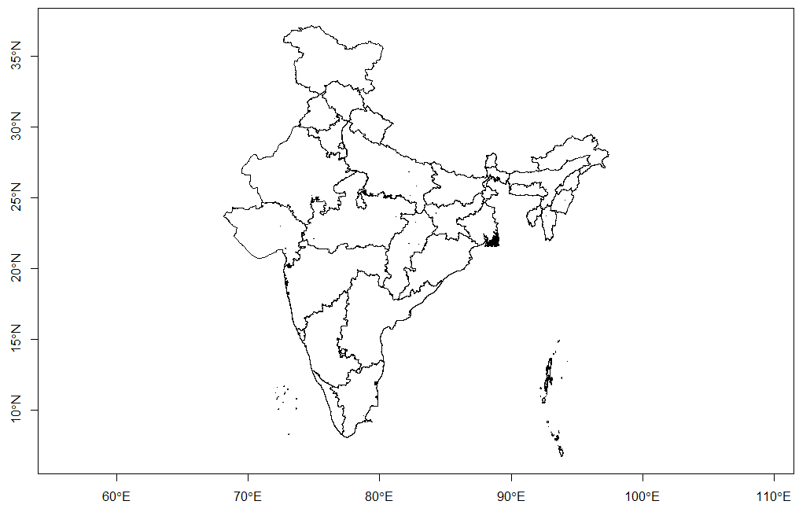

Slide 17
Apply Plotting Enhancements
map <- ggplot() + geom_polygon(data = ind,
aes(x = long, y = lat, group = group),
colour = "black", fill = NA)
## Regions defined for each Polygons
map + theme_void()

Slide 18
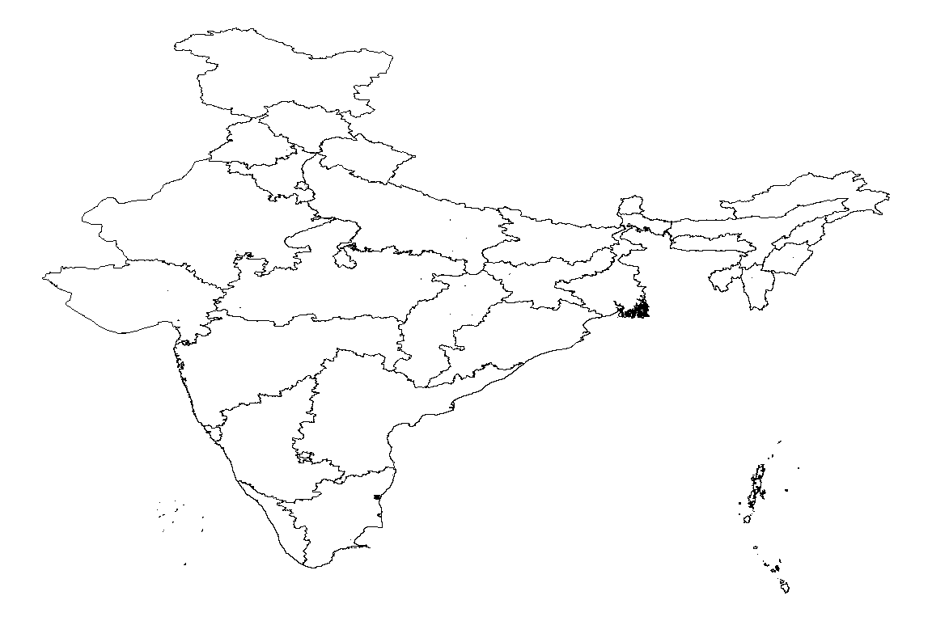

Slide 19
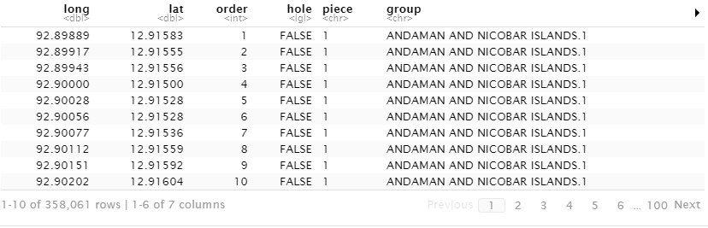
Show India Shape Table

Slide 20
Plot Map with Enhancements
map <- ggplot() + geom_polygon(data = ind,
aes(x = long, y = lat, group = group), colour = "black", fill = NA)
## Regions defined for each Polygons
cnames <- aggregate(cbind(long, lat) ~ id, data=shp_df, FUN=mean)
map + geom_text(data = cnames,
aes(x = long, y = lat, label = id), size = 4) + theme_void()

Slide 21
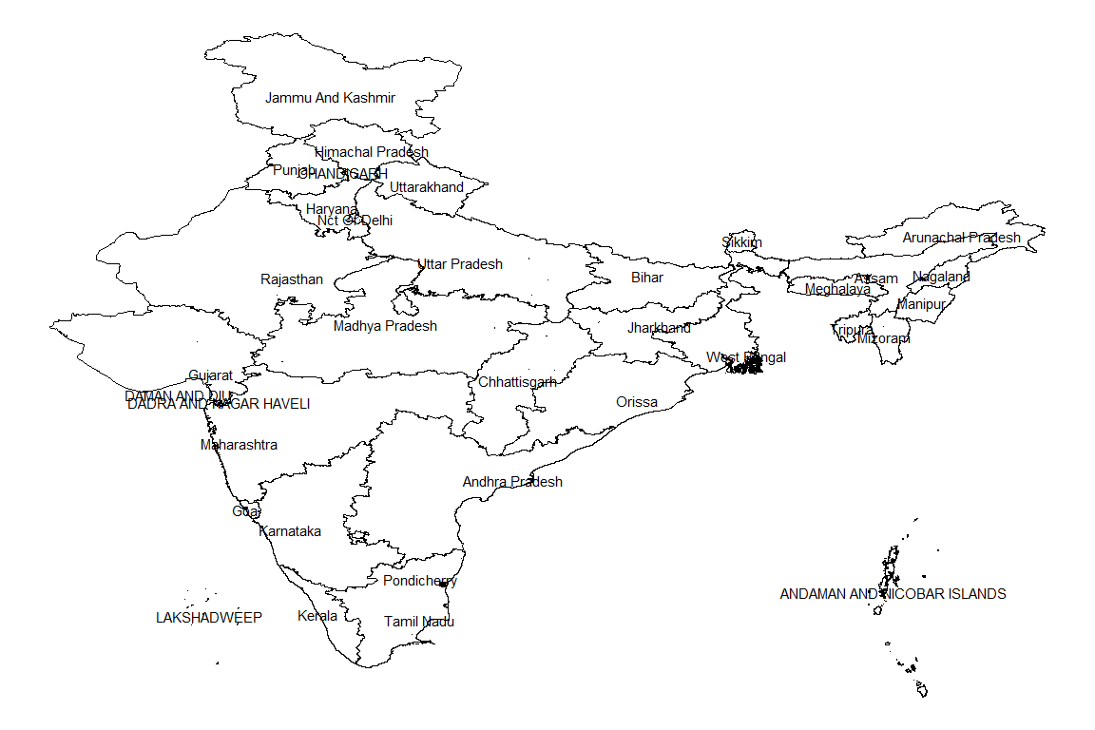

Slide 22
Setup Bounding Box for Indian Map
subscr<-data.frame(lon=c(79.1,79.15,79.2),lat=c(12.85,12.9,12.95),
pop=c(58,12,150))
coordinates(subscr)<-~lon+lat
proj4string(subscr)<-CRS("+init=epsg:4326")
lon <- c(78.9,79.3)
lat <- c(12.7,13.2)
map1<-get_map(location = c(lon[1], lat[2], lon[2], lat[1]), zoom=11)
## Warning: bounding box given to google - spatial extent only approximate.
## converting bounding box to center/zoom specification. (experimental)

Slide 23
Setup Bounding Box Plot
p <- ggmap(map1) + geom_point(data = as.data.frame(subscr),
aes(x = lon, y = lat, size=pop), colour = "darkgreen") + theme_bw()

Slide 24
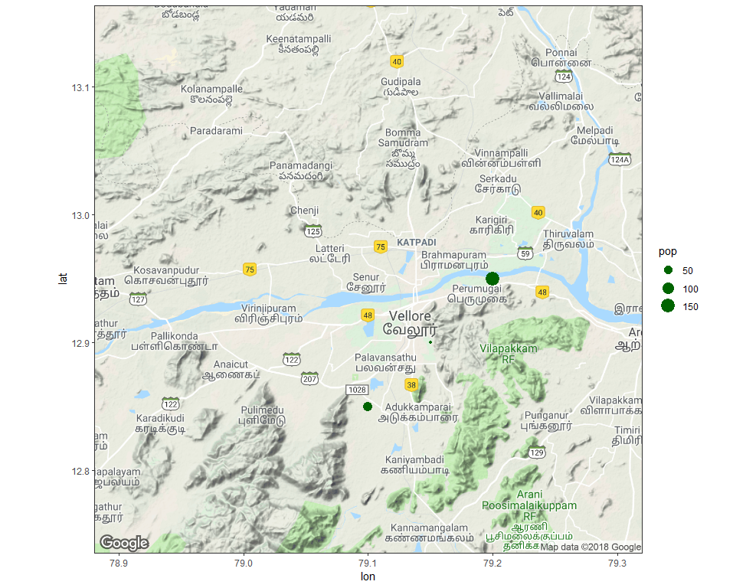
Plot Bounding Box Map
print(p)

Slide 25
Plot India Map with Grey Fill
requires (rgeos)
ind <- readOGR(dsn = mydir, layer = "INDIA")
## OGR data source with driver: ESRI Shapefile ## Source: "C:\Users\jeff\Documents\Crime Analysis\India_data", layer: "INDIA" ## with 35 features ## It has 1 fields
plot(ind, col = "grey")

Slide 26
Find Geographic centroids for Indian States
cent_ind <- gCentroid(ind[ind$ST_NAME == "Madhya Pradesh",]) cent_ind
## class : SpatialPoints ## features : 1 ## extent : 78.28915, 78.28915, 23.54119, 23.54119 (xmin, xmax, ymin, ymax) ## coord. ref. : +proj=longlat +ellps=WGS84 +no_defs

Slide 27
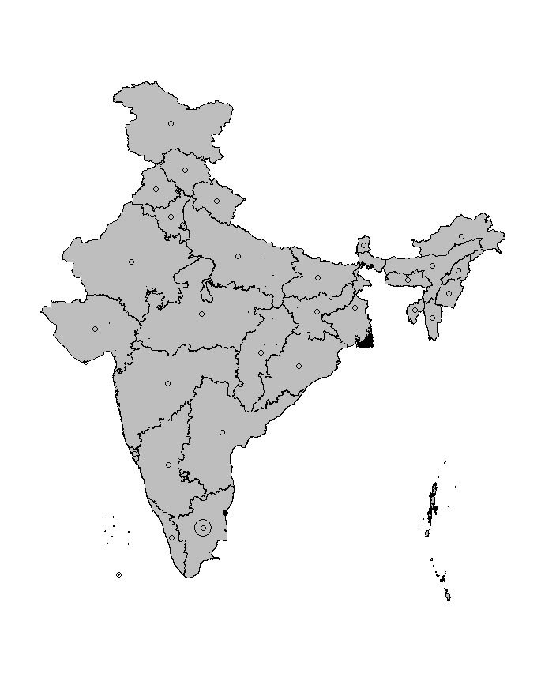
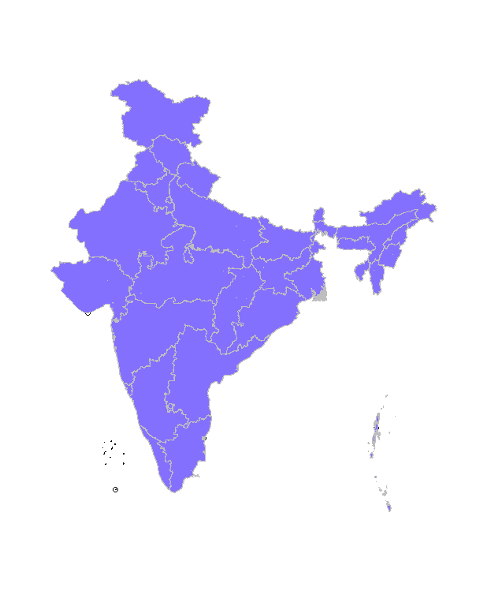
Plot Centoids with Fill and Borders

Slide 28
Selecting Quadrants for India
The code below should help understand the way spatial data work in R.
Find the centre of the India area
lat <- coordinates(gCentroid(ind))[[1]] lng <- coordinates(gCentroid(ind))[[2]]

Slide 29
Test whether or not a coordinate is east or north of the centre
east <- sapply(coordinates(ind)[,1], function(x) x > lat) north <- sapply(coordinates(ind)[,2], function(x) x > lng) ind@data$quadrant[east & north] <- "northeast"

Slide 30
Test whether or not a coordinate is east or north of the centre
east <- sapply(coordinates(ind)[,1], function(x) x > lat) south <- sapply(coordinates(ind)[,2], function(x) x < lng) ind@data$quadrant[east & south] <- "southeast"

Slide 31
Test whether or not a coordinate is east or north of the centre
west <- sapply(coordinates(ind)[,1], function(x) x < lat) north <- sapply(coordinates(ind)[,2], function(x) x > lng) ind@data$quadrant[west & north] <- "northwest"

Slide 32
Test whether or not a coordinate is east or south of the centre
west <- sapply(coordinates(ind)[,1], function(x) x < lat) south <- sapply(coordinates(ind)[,2], function(x) x < lng) ind@data$quadrant[west & south] <- "southwest"

Slide 33
Plot Quadrants with Different Fill Collors
plot(ind) plot(ind[east & north,], col = "red", add = TRUE) plot(ind[east & south,], col = "green", add = TRUE) plot(ind[west & north,], col = "blue", add = TRUE) plot(ind[west & south,], col = "yellow", add = TRUE) llgridlines(ind, lty= 3, side ="EN", offset = -0.5)

Slide 34
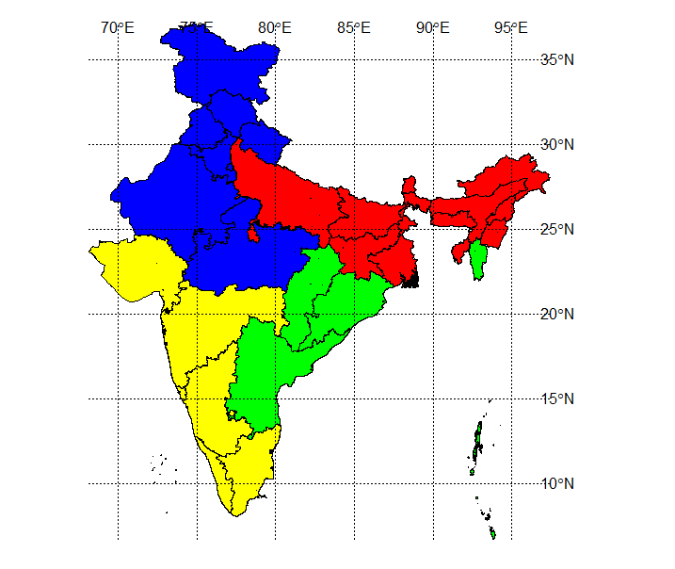
Four Quadrants of India

Slide 35
Plot SE Quadrants with Red Fill Collors
ind$quadrant[east & north] <- "northest" ind$quadrant[!east & !north] <- "southwest" ind$quadrant[!east & north] <- "Northwest" plot(ind) plot(ind[east & !north,], add = TRUE, col = "red" ) llgridlines(ind, lty= 3, side ="EN", offset = -0.5)

Slide 36
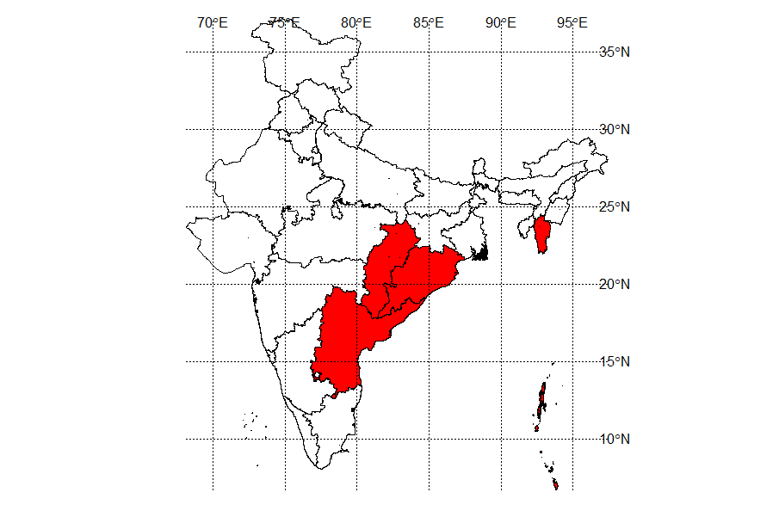
Southeast Quadrant of India

Slide 37
Creating New R Object
Alongside visualisation and interrogation, a GIS must also be able to create and modify spatial data.
R’s spatial packages provide a very wide and powerful suite of functionality for processing and creating spatial data.
R objects can be created by entering the name of the class we want to make.
vector and data.frame objects for example, can be created as follows:
vec <- vector(mode = "numeric", length = 3) df <- data.frame(x = 1:3, y = c(1/2, 2/3, 3/4))

Slide 38
Check the class of new objects using class():
class(vec)
## [1] "numeric"
class(df)
## [1] "data.frame"

Slide 39
Creating New Spatial Data
The same logic applies to spatial data.
The input must be a numeric matrix or data.frame:
sp1 <- SpatialPoints(coords = df)

Slide 40
COmment on reating Spatial Data
We have just created a spatial points object, one of the fundamental data types for spatial data.
(The others arelines, polygons and pixels,which can be created by SpatialLines,SpatialPolygons and SpatialPixels, respectively.)
Each type of spatial data has a corollary that can accepts non-spatial data, created by adding DataFrame.
SpatialPointsDataFrame(), for example, creates points with an associated data.frame.
The number of rows in this dataset must equal the number of features in the spatial object, which in the case of sp1 is 3.

Slide 41
Add Data to an Existing Spatial Data File
The code below extends the pre-existing object sp1 by adding data from df.
To see how strict spatial classes are, try replacing df with mat in the above code: it causes an error.
All spatial data classes can be created in a similar way, although SpatialLines and SpatialPolygons are much more complicated (Bivand et al. 2013).
More frequently your spatial data will be read-in from an externally-created file, e.g. using readOGR().
Unlike the spatial objects we created above, most spatial data comes with an associate ‘CRS’.
class(sp1)
## [1] "SpatialPoints" ## attr(,"package") ## [1] "sp"
spdf <- SpatialPointsDataFrame(sp1, data = df) class(spdf)
## [1] "SpatialPointsDataFrame" ## attr(,"package") ## [1] "sp"

Slide 42
Projections: setting and transforming CRS in R
The Coordinate Reference System (CRS) of spatial objects defines where they are placed on the Earth’s surface.
You may have noticed ’proj4string ’in the summary of ind above: the information that follows represents its CRS.
Spatial data should always have a CRS.
If no CRS information is provided, and the correct CRS is known, it can be set as follow:
proj4string(ind) <- NA_character_ # remove CRS information from ind proj4string(ind) <- CRS(“+init=epsg:27700”) # assign a new CRS

Slide 43
Comments on CRS Changes
R issues a warning when the CRS is changed.
This is so the user knows that they are simply changing the CRS, not reprojecting the data.
An easy way to refer to different projections is via EPSG codes.
Under this system 27700 represents the British National Grid.
‘WGS84’ (epsg:4326) is a very commonly used CRS worldwide.

Slide 44
Find EPSG Codes
The following code shows how to search the list of available EPSG codes and create a new version of ind in WGS84:3
proj4string(ind)
## [1] "+proj=longlat +ellps=WGS84 +no_defs"

Slide 45
Convert the Coordinates
spTransform converts the coordinates of ind into the widely used WGS84CRS.
CRS("+init=epsg:4326")
## CRS arguments: ## +init=epsg:4326 +proj=longlat +datum=WGS84 +no_defs +ellps=WGS84 ## +towgs84=0,0,0
CRS("+init=epsg:3785")
## CRS arguments: ## +init=epsg:3785 +proj=merc +a=6378137 +b=6378137 +lat_ts=0.0 ## +lon_0=0.0 +x_0=0.0 +y_0=0 +k=1.0 +units=m +nadgrids=@null ## +no_defs

Slide 46
Change the EPSG
## code note prj4 ## 249 4326 # WGS 84 +proj=longlat +datum=WGS84 +no_defs ## 5311 4978 # WGS 84 +proj=geocent +datum=WGS84 +units=m +no_defs
## class : SpatialPolygonsDataFrame ## features : 35 ## extent : 7583106, 10844206, 753627.8, 4458031 (xmin, xmax, ymin, ymax) ## coord. ref. : +init=epsg:3785 +proj=merc +a=6378137 +b=6378137 +lat_ts=0.0 +lon_0=0.0 +x_0=0.0 +y_0=0 +k=1.0 +units=m +nadgrids=@null +no_defs ## variables : 2 ## names : ST_NAME, quadrant ## min values : ANDAMAN AND NICOBAR ISLANDS, northest ## max values : West Bengal, southwest

Slide 47
Saving CRS Formats
Now we’ve transformed ind into a more widely used CRS, it is worth saving it.
R stores data effciently in .RData or .Rds formats.
The former is more restrictive and maintains the object’s name, so we use the latter
saveRDS(object = ind84, file = "C:/Users/jeff/Documents/Crime Analysis/Creating-maps-in-R-master/data/ind84.Rds")

Slide 48
Reset INDIA Shapefile
To reaffirm our starting point, let’s re-load the “INDIA” shapefile as a new object and plot it:
Create new object called “ind” from “INDIA” shapefile
ind <- readOGR(dsn = mydir, "INDIA")
## OGR data source with driver: ESRI Shapefile ## Source: "C:\Users\jeff\Documents\Crime Analysis\India_data", layer: "INDIA" ## with 35 features ## It has 1 fields
plot(ind)

Slide 49
Joing Non-Spatial and Spatial data
The non-spatial data we are going to join to the ind object contains records of population in India.
This is stored in a comma separated values (.csv) file called “India_pop_2011”.
If you open the file in a separate spreadsheet application first, we can see each row represents a single city’s population.
We are going to use a function called aggregate to aggregate the population at the city, ready to join to our spatial ind dataset.
A new object called india_pop is created to store this data.

Slide 50
India 2011 Population
india_pop <- read.csv("C:/Users/jeff/Documents/Crime Analysis/India_data/India_pop_2011.csv",
stringsAsFactors = FALSE)
datatable(india_pop, options = list(scrollX='400px'))

Slide 51
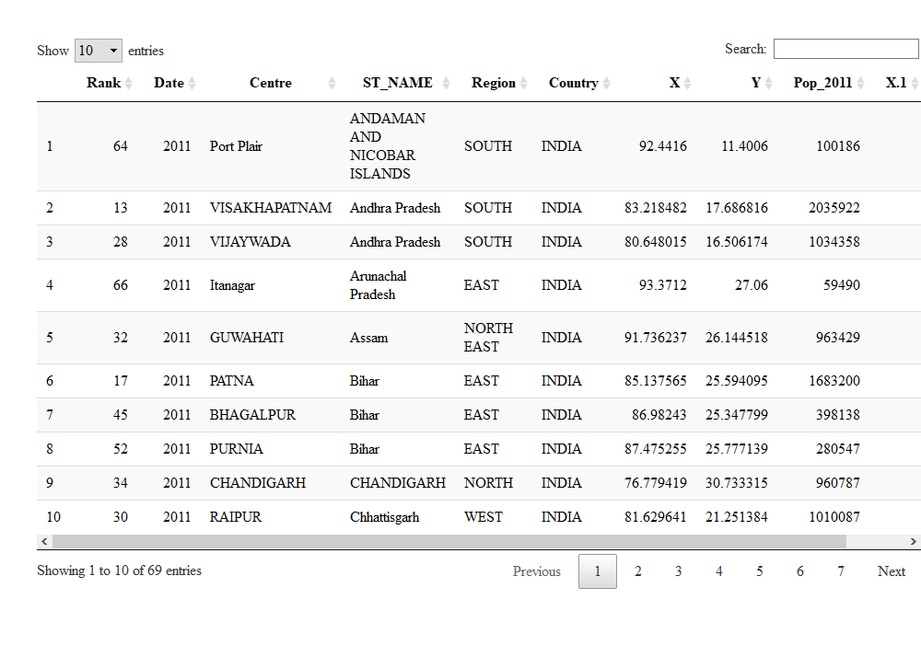
2011 Population by City

Slide 52
Joining Tables
We use left_join because we want the length of the data frame to remain unchanged, with variables from new data appended in new columns (see ?left_join).
The *join commands (including inner_join and anti_join) assume, by default, that matching variables have the same name.
Here we will specify the association between variables in the two data sets:
head(ind$ST_NAME) # dataset to add to (results not shown)
## [1] ANDAMAN AND NICOBAR ISLANDS Andhra Pradesh Arunachal Pradesh
## [4] Assam Bihar CHANDIGARH ## 35 Levels: ANDAMAN AND NICOBAR ISLANDS ... West Bengal
head(india_pop$ST_NAME) # the variables to join
## [1] "ANDAMAN AND NICOBAR ISLANDS" "Andhra Pradesh" "Andhra Pradesh"
## [4] "Arunachal Pradesh" "Assam" "Bihar"
ind@data <- left_join(ind@data, india_pop, by = c('ST_NAME' = 'ST_NAME'))

Slide 53
Basic Scatterplots
attach(india_pop) plot(X,Y) + text(X,Y, labels=india_pop$Centre)

Slide 54
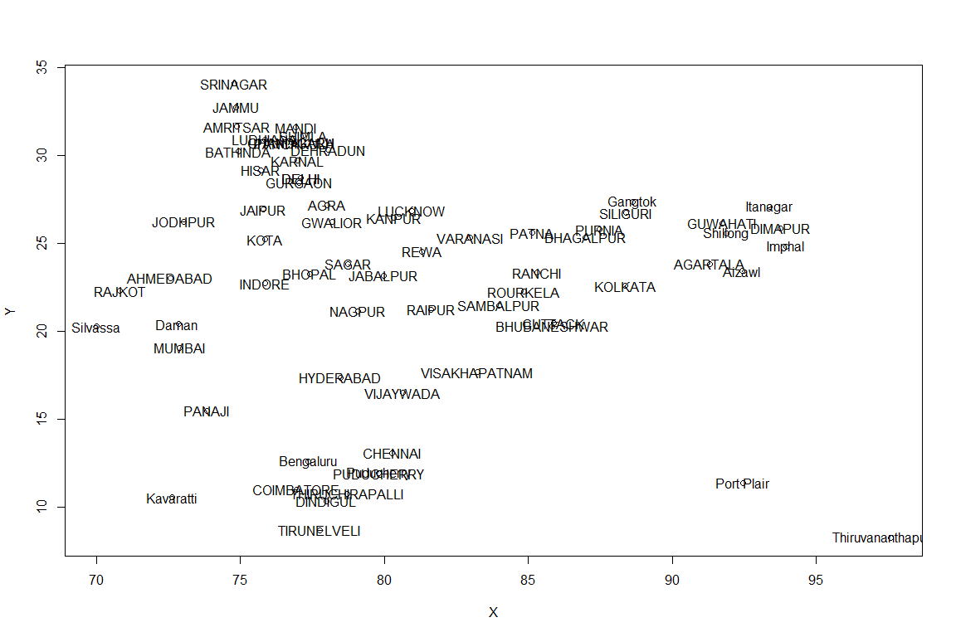
Basic Scatterplot with City Labels

Slide 55
India.shp Map Rescaled with lat/long Grids
require(ggplot2) map <- ggplot() + geom_polygon(data = ind,
aes(x = long, y = lat, group = group), colour = "black", fill = NA)
## Regions defined for each Polygons
map + theme_void()

Slide 57
India.shp Map with States
map <- ggplot() + geom_polygon(data = ind,
aes(x = long, y = lat, group = group), colour = "black", fill = NA)
## Regions defined for each Polygons
cnames <- aggregate(cbind(long, lat) ~ id, data=shp_df, FUN=mean)
map + geom_text(data = cnames,
aes(x = long, y = lat, label = id), size = 4) + theme_void()

Slide 58


Slide 59
India.shp Map with Cities
ggplot(india_pop, aes(X,Y)) + geom_point() +
geom_text(aes(label=Centre)) +
geom_polygon(data = ind,
aes(x = long, y = lat, group = group), colour = "black", fill = NA)
## Regions defined for each Polygons

Slide 60
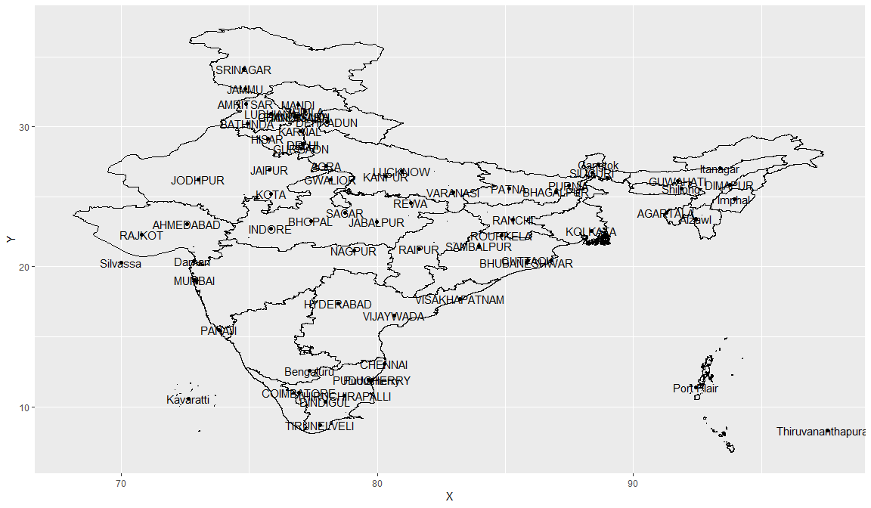

Slide 61
India Map with Sates Setup
library(tmaptools) ind_wgs = spTransform(ind, CRS("+init=epsg:4326")) osm_tiles = read_osm(bbox(ind_wgs)) ind_wgs$ST_NAME <- ind$ST_NAME

Slide 62
Plot India Map with States (colored)
tm1<-tm_shape(osm_tiles) + tm_raster() + tm_shape(ind_wgs) + tm_fill("ST_NAME", legend.show=TRUE) + tm_layout(legend.position = c(0.99,0.02)) tm1

Slide 63
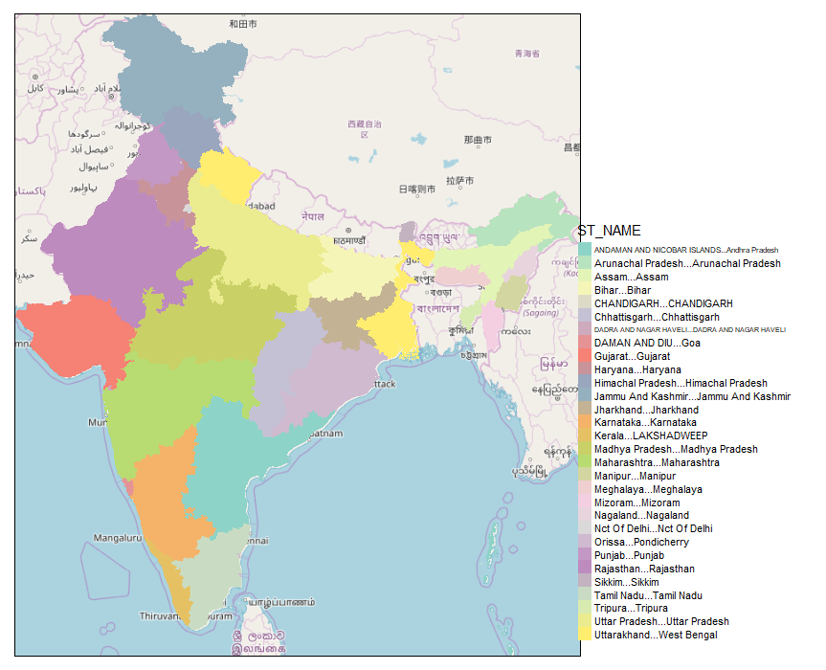
Color-Code State Map of India

Slide 64
India Population Mask (colored)
tm2<-tm_shape(ind_msk_pop) + tm_raster() tm2

Slide 65
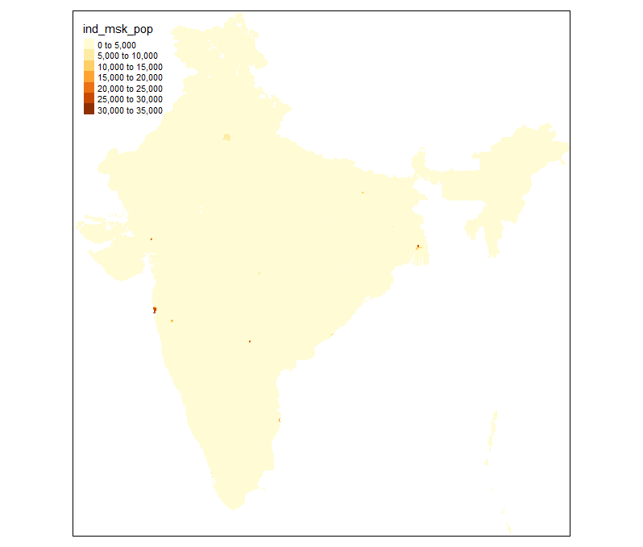
Population Mask Layer

Slide 66
Define Popups for Leaflet Map
india_pop$popup <- paste("<b>Rank #: </b>", india_pop$Rank, "<br>", "<b>City: </b>", india_pop$Centre, "<br>", "<b>Region: </b>", india_pop$Region, "<br>", "<b>State: </b>", india_pop$ST_NAME, "<br>", "<b>Coountry: </b>", india_pop$Country, "<br>", "<b>Date: </b>", india_pop$Date, "<br>", "<b>Population: </b>", india_pop$Pop_2011, "<br>", "<b>Longitude: </b>", india_pop$X, "<br>", "<b>Latitude: </b>", india_pop$Y)

Slide 67
India Leaflet Population Map
library(leaflet)
leaflet(india_pop, width = "100%") %>% addTiles() %>%
addTiles(group = "OSM (default)") %>%
addProviderTiles(provider = "Esri.WorldStreetMap",
group = "World StreetMap") %>%
addProviderTiles(provider = "Esri.WorldImagery",
group = "World Imagery") %>%
addMarkers(lng = ~X, lat = ~Y, popup = india_pop$popup,
clusterOptions = markerClusterOptions()) %>%
addLayersControl(baseGroups =
c("OSM (default)","World StreetMap", "World Imagery"),
options = layersControlOptions(collapsed = FALSE) )

Slide 68
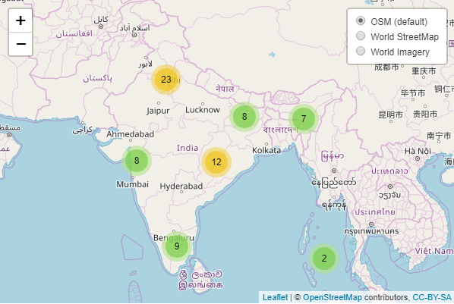
OSM of India

Slide 69
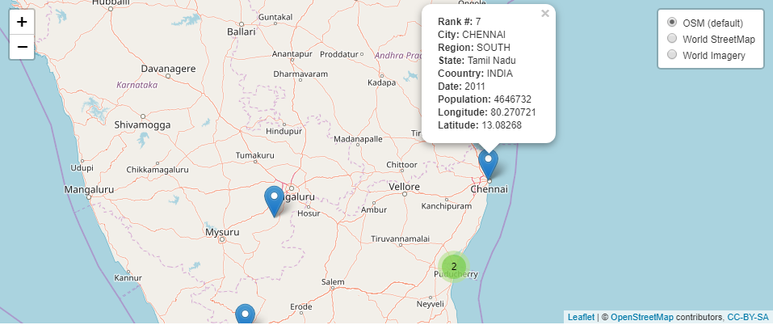
Popups

